Slide 1
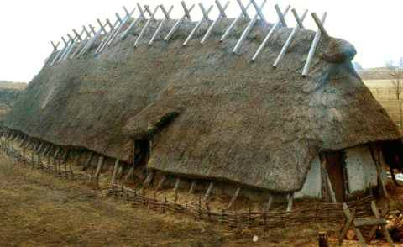
LKS2 Topic: Invaders and settlers: Vikings Block: Viking Way of Life Session 2
All
about
a Viking longhouse
© Original resource copyright Hamilton Trust, who give permission for it to be adapted as wished by individual users.
We refer you to our warning, at the foot of the block overview, about links to other websites.

Slide 2
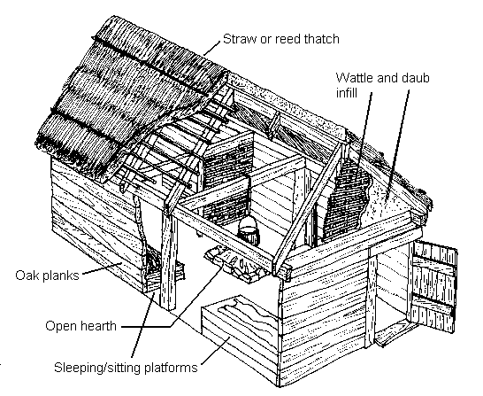
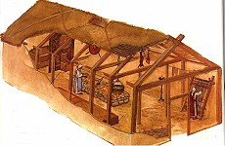
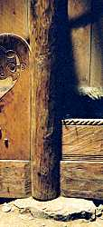
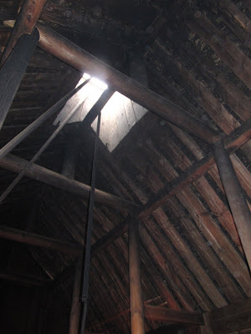
How it is built
A wooden frame is constructed.
Most Viking homes were just one room, a long box shape.
This room was shared by all the family and sometimes their animals.
Why is this done?
Why is a hole left in the roof?
The uprights are put on a stone.

Slide 3
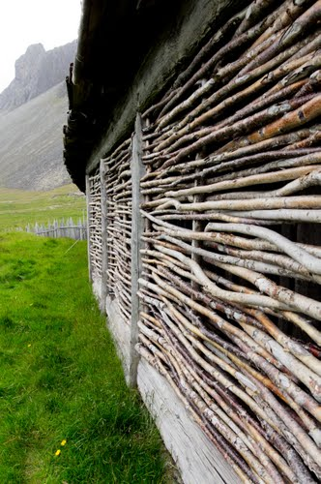
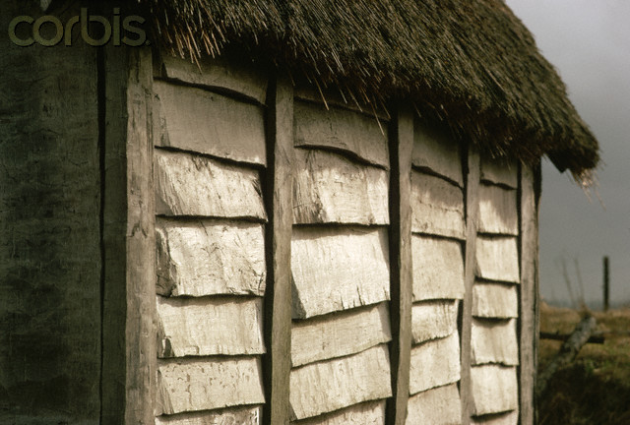
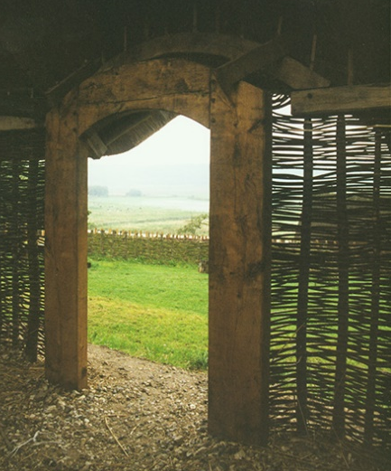
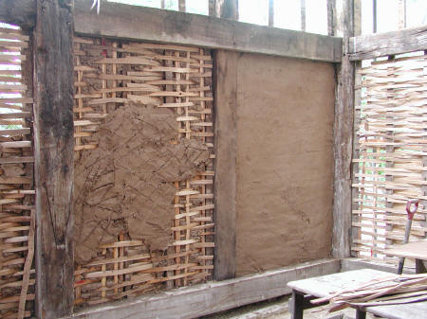
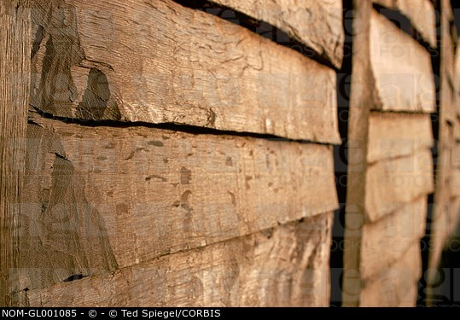
Walls
Wattle: Sticks woven around upright posts Daub: Mud, manure, clay, and grass/hay mixed with water until it is a thick mixture, which is then smeared on the wattle to close the gaps
Timber: Wooden planks over lap to keep out the wind. The gaps were filled with mud.

Slide 4
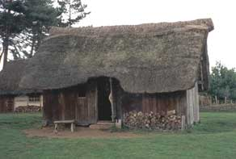
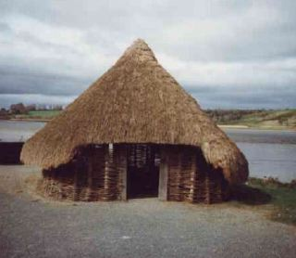
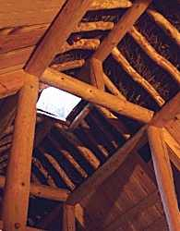
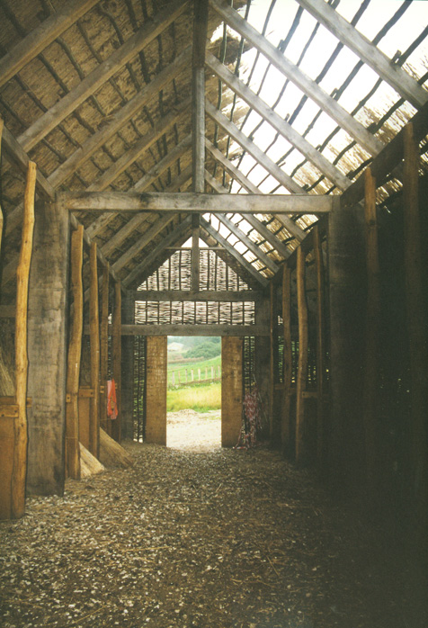
Roof
The roof is made of straw or thatch or reeds a type of grass.
It keeps out the wind and rain.
The roof is very sloped so the rain and snow slides off.
The roof over hangs the walls so
they are cool and dry.
There was no chimney so
the smoke from the open fire drifted out through the roof.

Slide 5
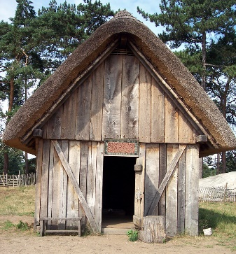
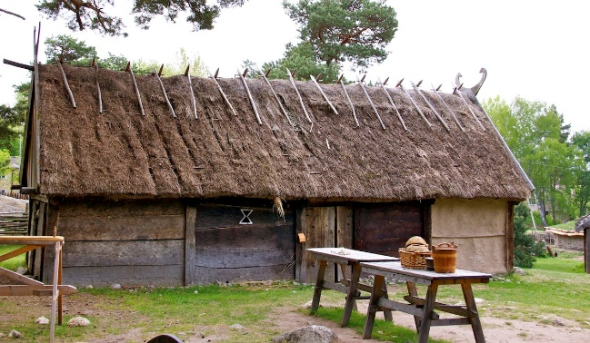
Doors and Windows
The only light came from oil lamps or the fire.
What is your door made of?
There was only one small wooden door in the house.
How many windows are in your home?
It was dark inside because they only had a small window or none at all. The window was covered with an animal skin or wooden shutters.

Slide 6
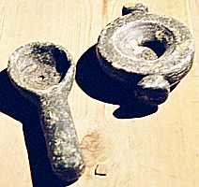
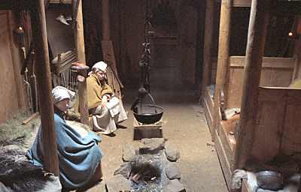
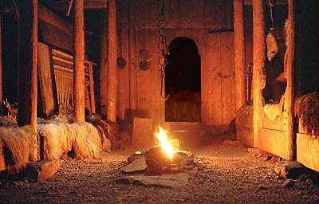
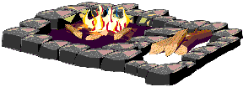
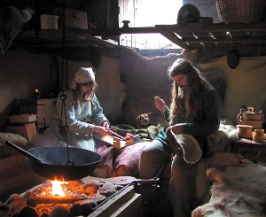
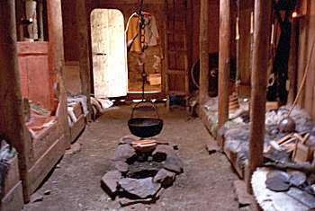
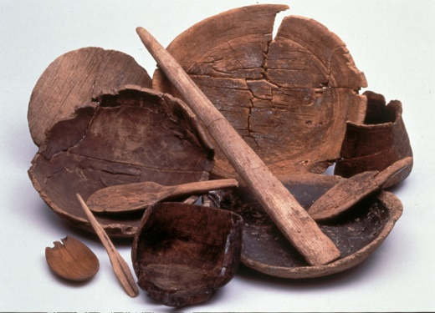
Inside the long house
A cauldron was hung over the fire to cook the food.
The fire in the centre
of the room gave out
light and heat.
The smoke filled the room and eventually drifted up to the hole in the roof
Oil lamps

Slide 7
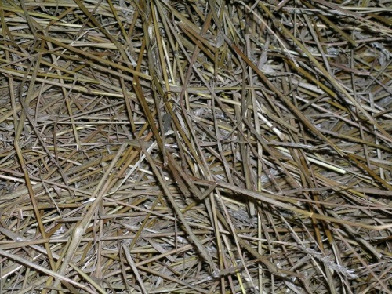
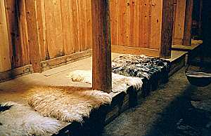
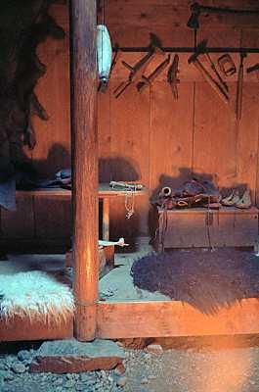
Inside the long house
The floor was soil or stones. They had no carpets, so some Vikings placed rushes, leaves and grass on the floor.
Benches for sitting or sleeping on were around the walls. They were made from wood and straw and when the Vikings went to bed they covered themselves with animal skins, fur or cloths for warmth or comfort.
Beds were only used in the wealthier houses
When it was day they used the bench as a chair to sit on.
They didn’t have a table or chairs.

Slide 8
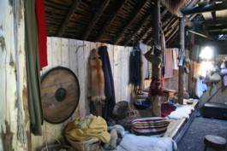
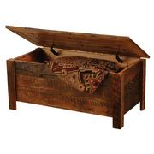
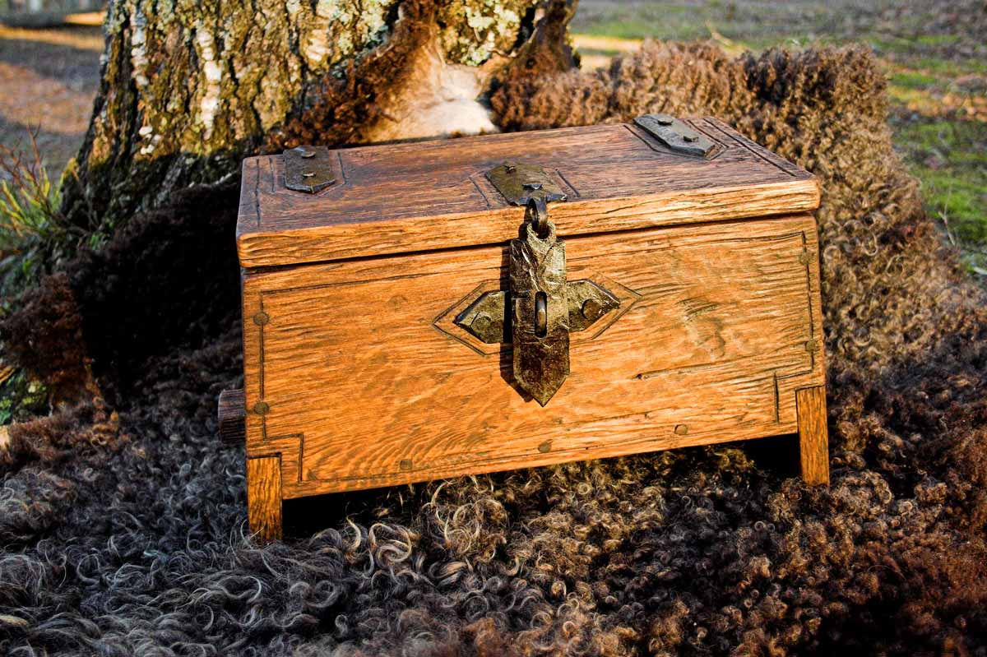
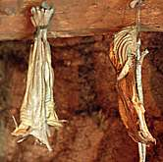
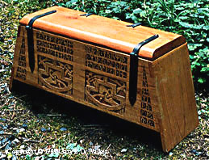
Storage
There was no furniture in the longhouse.
Items were hung from the walls or beams.
Cists or Chests were used to store things in. They were carved and made of wood.
Even the animals were kept indoors at one end of the longhouse.

