Slide 1
Hello There
Welcome back to school!
We’ve missed you so much.

Slide 2
How many rainbows can you find?

Slide 3
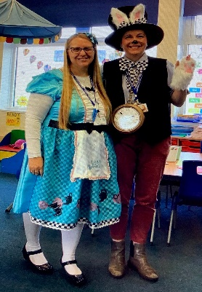
We have all missed you so much!

Slide 4
What changes have there been?
Things have been quite strange for the past few weeks, and we’ve had to stay at home a lot.
Now we’re coming back to school and things are a little different, but some things are the same.
Let’s talk about...
What is different?
What is the same?

Slide 5
Things that are different
We won’t all gather together
We still need to keep social distancing
We will be working in smaller groups
Not everyone will be back in school at the same time. They might come to school on a different day to us.
We will have less equipment to use.

Slide 6
Things that are the same
We still have all the same friends.
We have the same teachers and school staff.
People at school will still care for us and keep us safe.
Zoom catch ups will continue in the afternoons so we will be able to see all of our friends.

Slide 7
What’s happening now
Schools have been partially closed for a little while, but they will be open again for everyone when it is safe. We will let you know when this will happen.
Some of the places we go to like cinemas, parks and cafes might stay closed for a while but don’t worry, they will open again.
We need to stay at home for a bit longer, but things will get back to normal when it is safe..

Slide 8
What has stayed the same
Lots of things have stayed the same, so you don’t need to worry.
We can still go out for walks
We still live in the same place
We still have all our things around us.
We still have people to love and care for us.

Slide 9
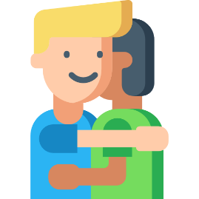
How we are going to stay safe in school
Coronavirus is passed from person to person, so for a while we have to stop doing some things like:-
Being really close to
other people
Giving high fives
Shaking hands
Hugging our friends
Instead we can...
Wave to each other
Hug ourselves
Thumbs Up
Smile lots

Slide 10
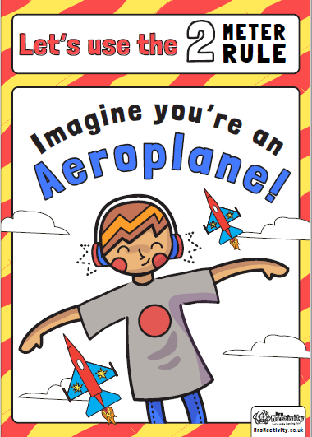
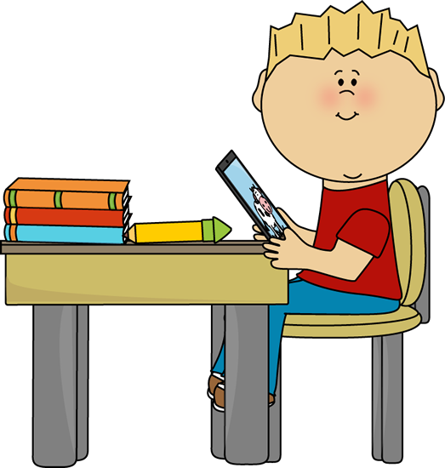
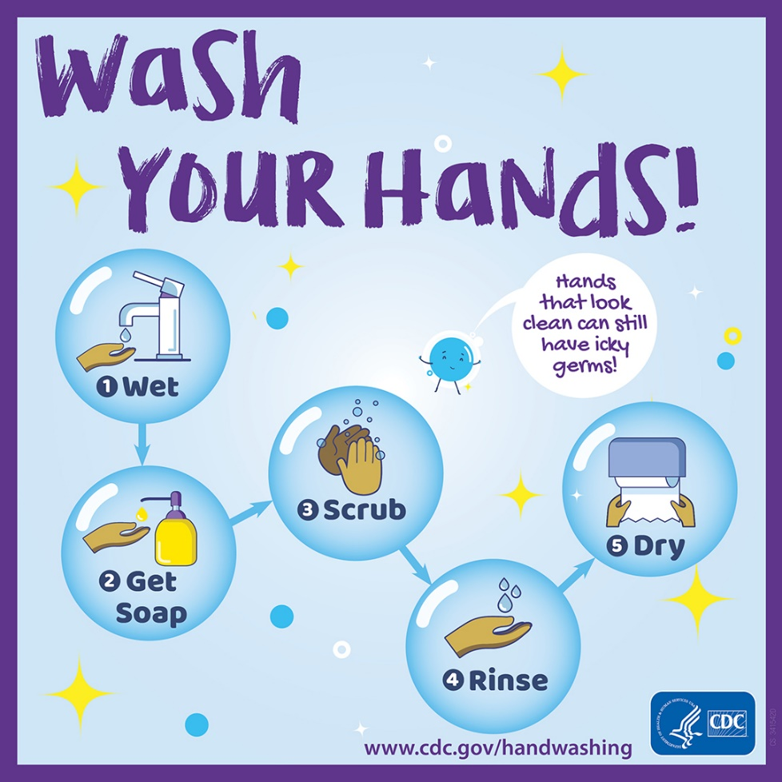
How we are going to stay safe in school
Social Distancing
Working at your own desk
Washing our hands regularly.

Slide 11
During lockdown there has been lots of people working hard to keep us all safe and healthy – can you think of any more?
Doctors
Nurses
Teachers
Teaching assistants
Supermarket workers
Bin workers
Fire fighters
Ambulance drivers
Nursery workers
Social workers
Midwives
Care workers
Police officers
Armed forces
Rail workers
Bus drivers

Slide 12
Do you have any worries or fears?
Sharing is caring!
Tell the rest of the class, probably everyone is feeling the same way, and we can talk about it together.
Remember it is completely normal – you can always tell an adult anytime you like.

Slide 13
You don’t need to feel worried because:-
Grown ups will keep you safe.
Everything will go back to normal soon.
You are special and loved.
Coronavirus will go away soon, and things will go back to normal.

Slide 14
When you arrive/leave school
Please make sure you are following
the social distancing lines that have been
put in place.
Quickly leave the school site and don’t
congregate outside.
Please only arrive at school with a named
coat and a water bottle. We will keep
your reading books at school.

Slide 15
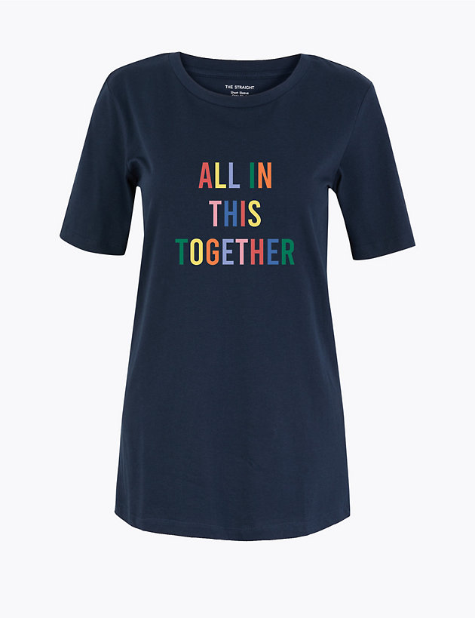
Keep an eye on our t-shirts or badges

Slide 16
We can’t wait to see you very soon!!
How many rainbows did you count?

