Slide 1
Reception Autumn Scheme of Learning

Slide 2
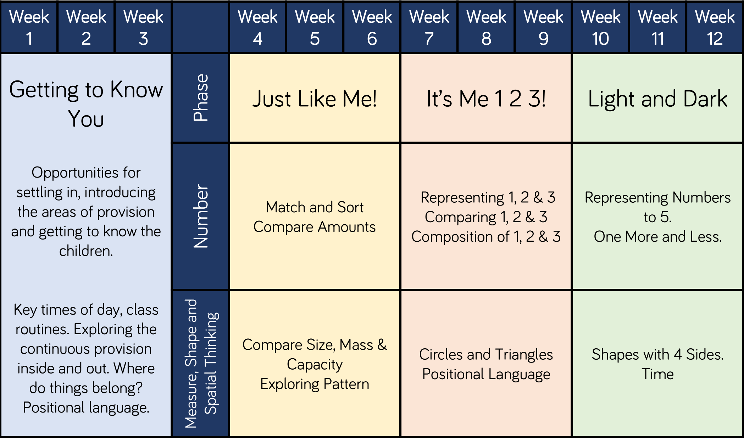
Reception

