Slide 1
Reception Spring Scheme of Learning

Slide 2
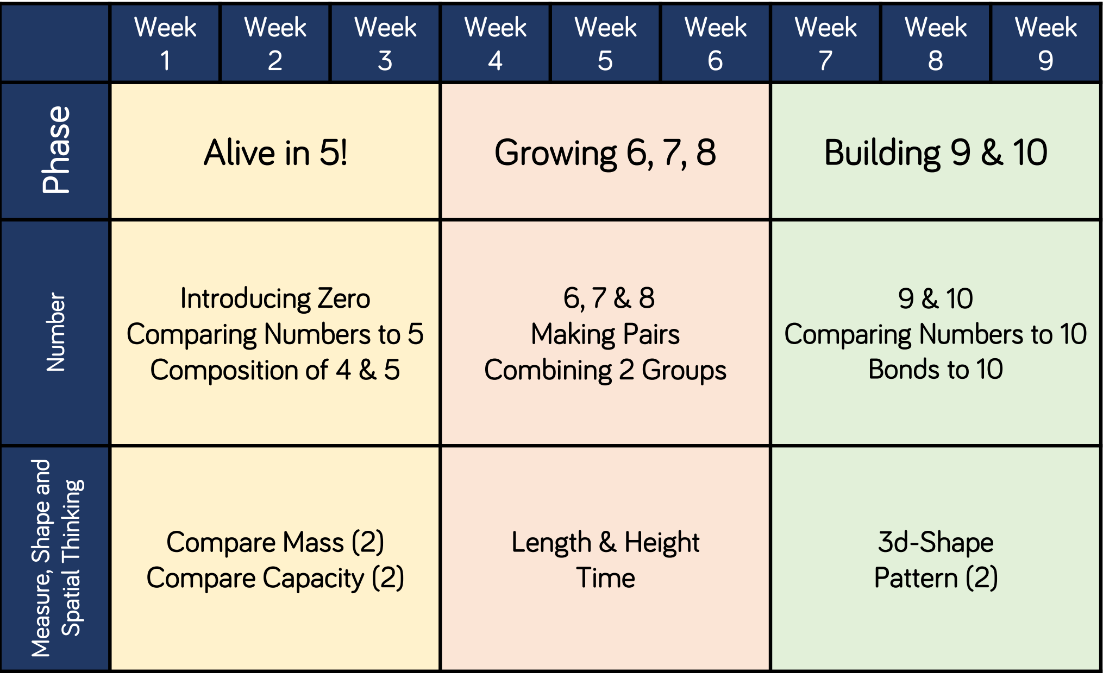
Reception

