Slide 1
Year 1 Spring Scheme of Learning

Slide 2
Year 1

Slide 3
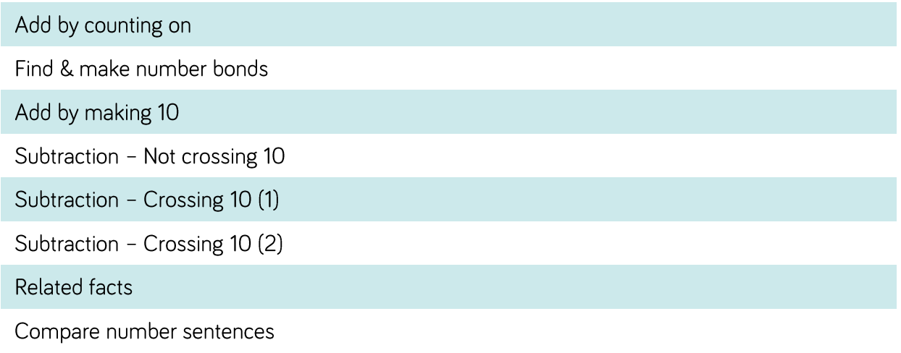
Year 1

Slide 4
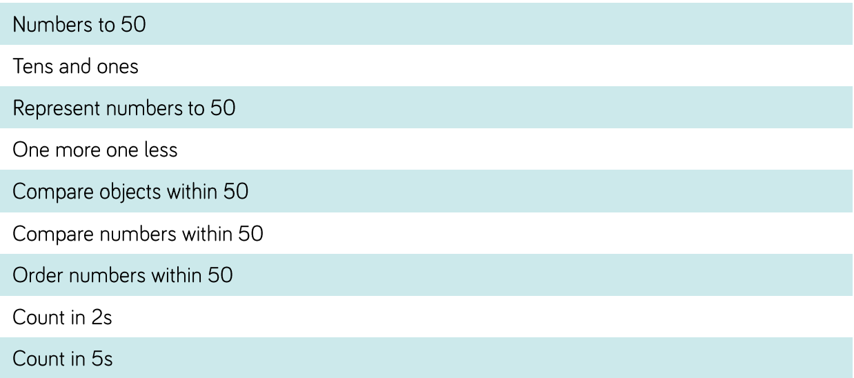
Year 1

Slide 5
Year 1

Slide 6
Year 1

