Slide 1
Year 2 Spring Scheme of Learning

Slide 2
Year 2

Slide 3
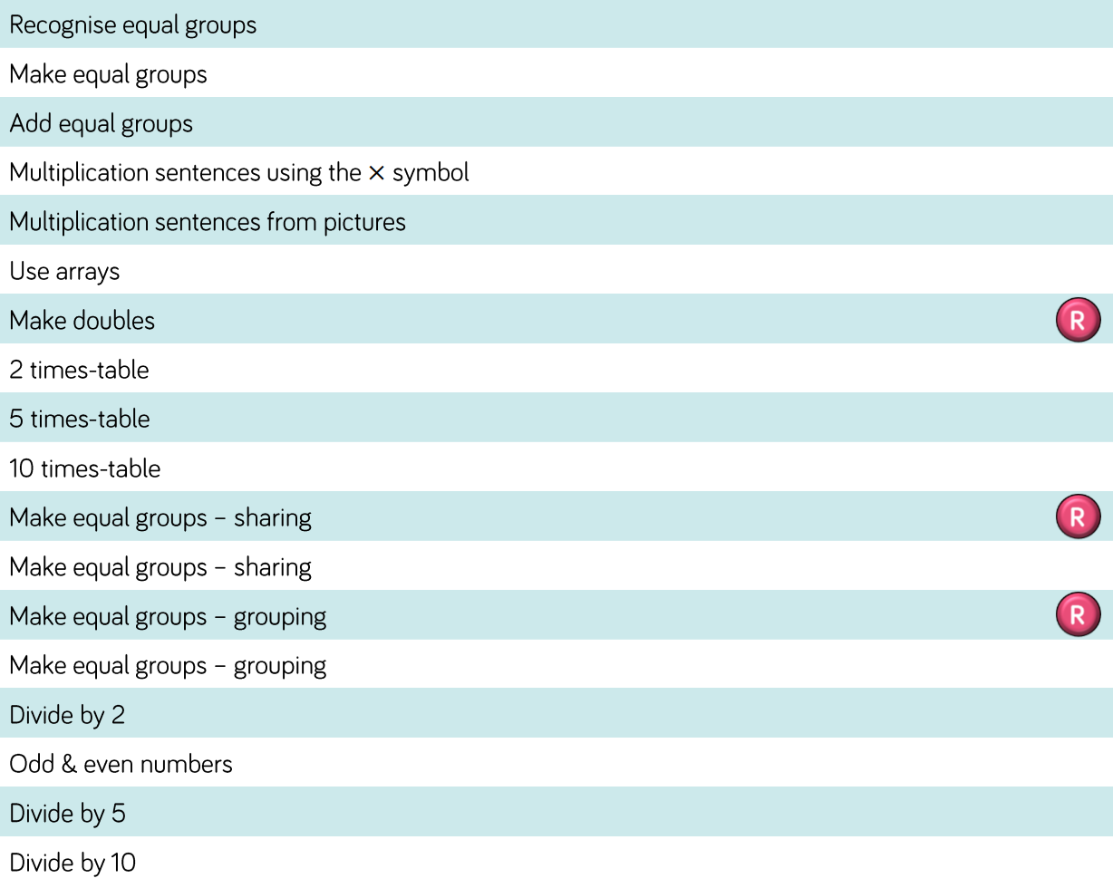
Year 2

Slide 4
Year 2

Slide 5
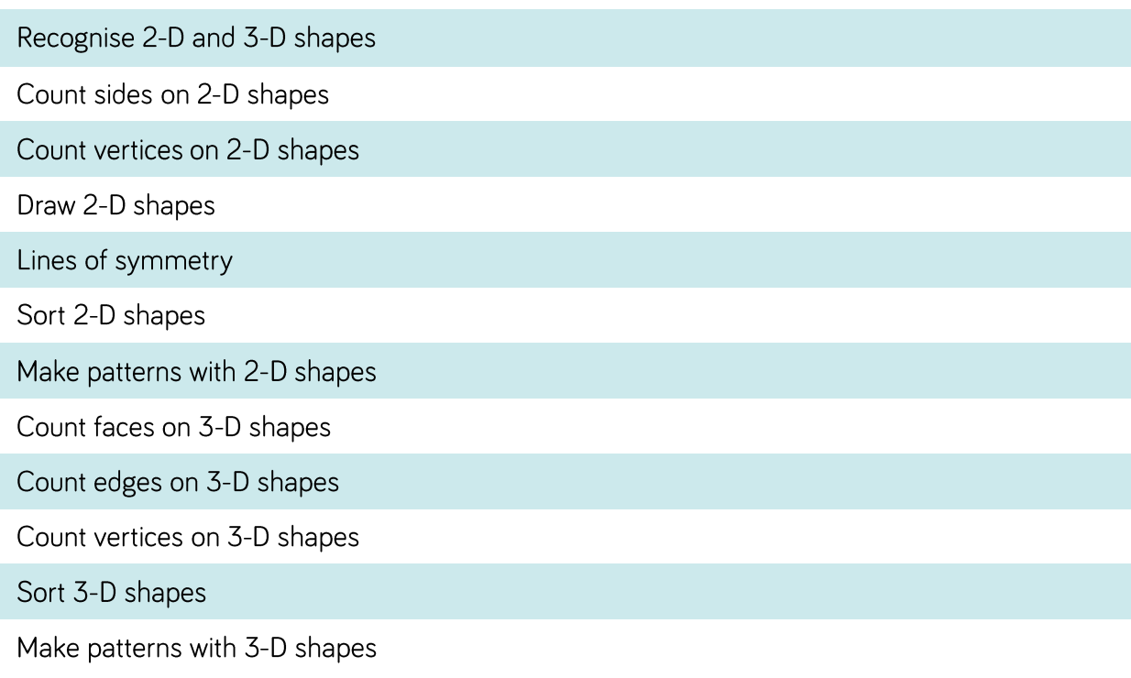
Year 2

Slide 6
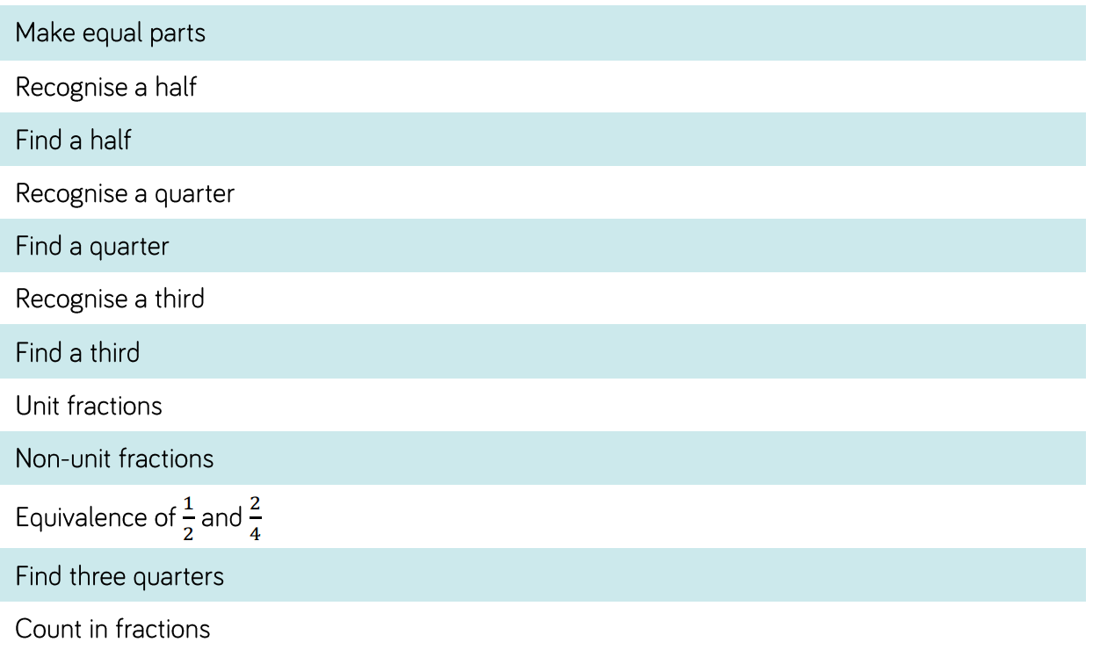
Year 2

