Slide 1

Year 5 Autumn Scheme of Learning

Slide 2
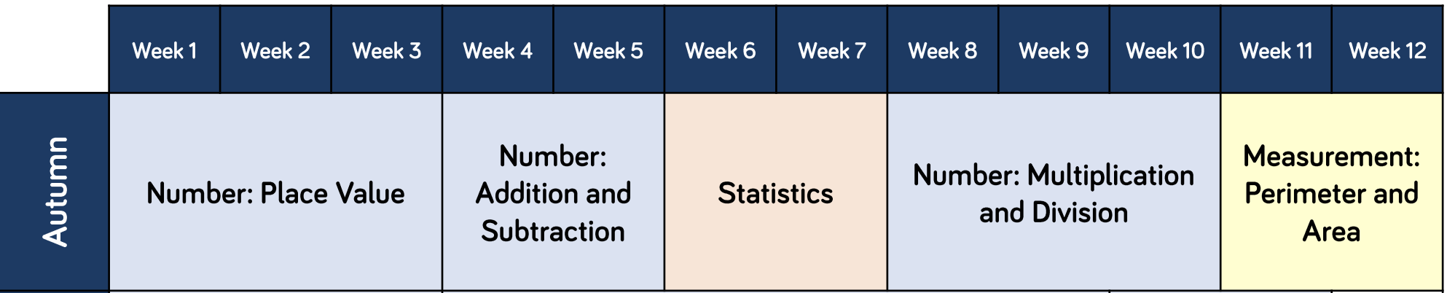
Year 5

Slide 3
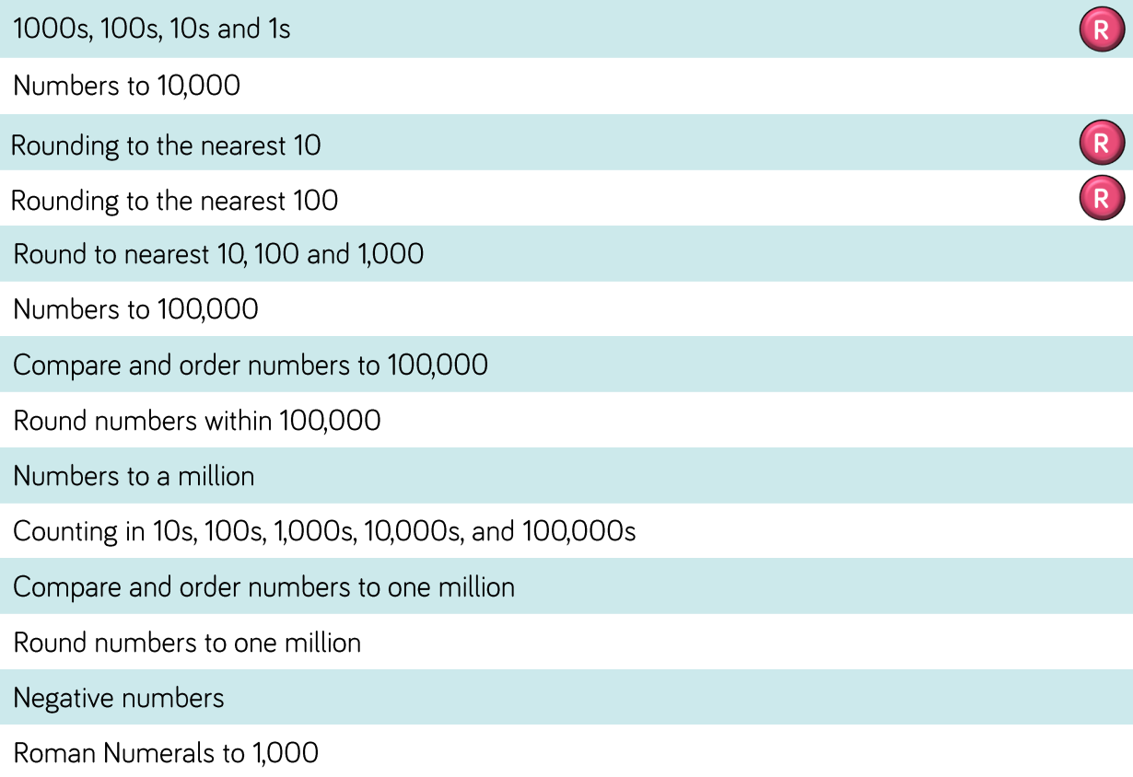
Year 5

Slide 4
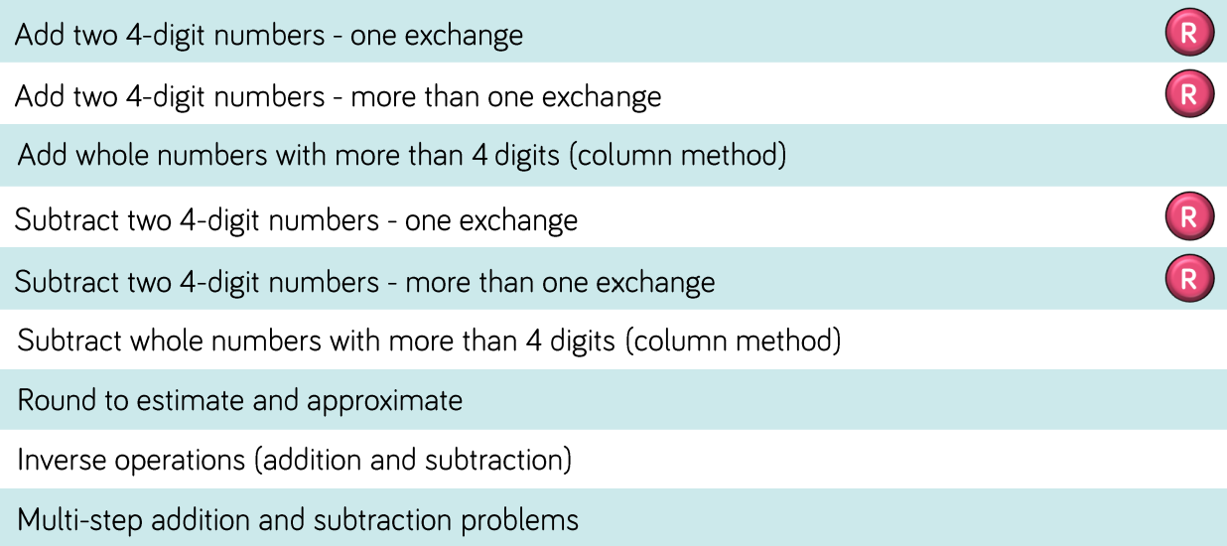
Year 5

Slide 5
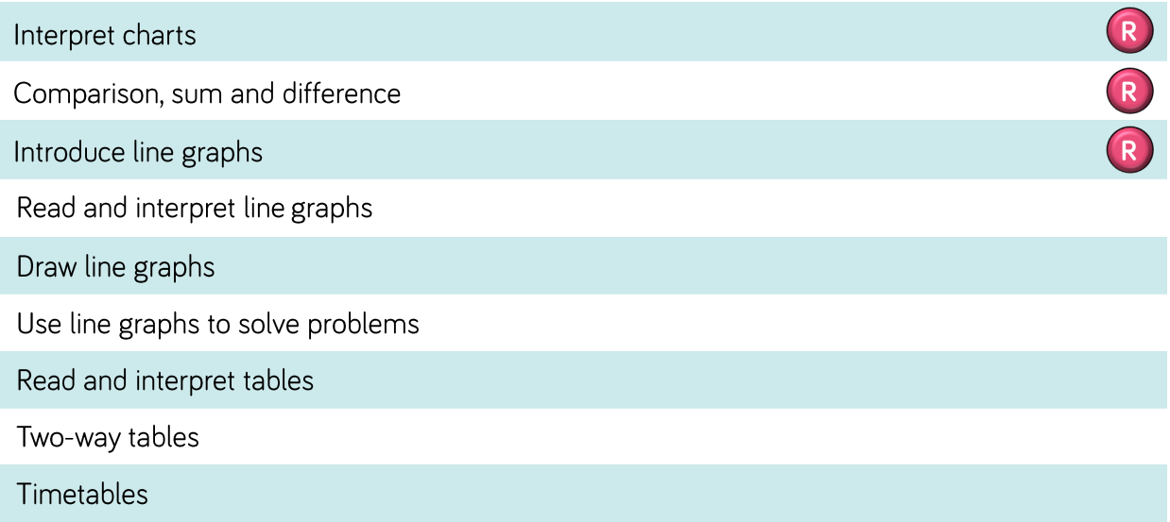
Year 5

Slide 6
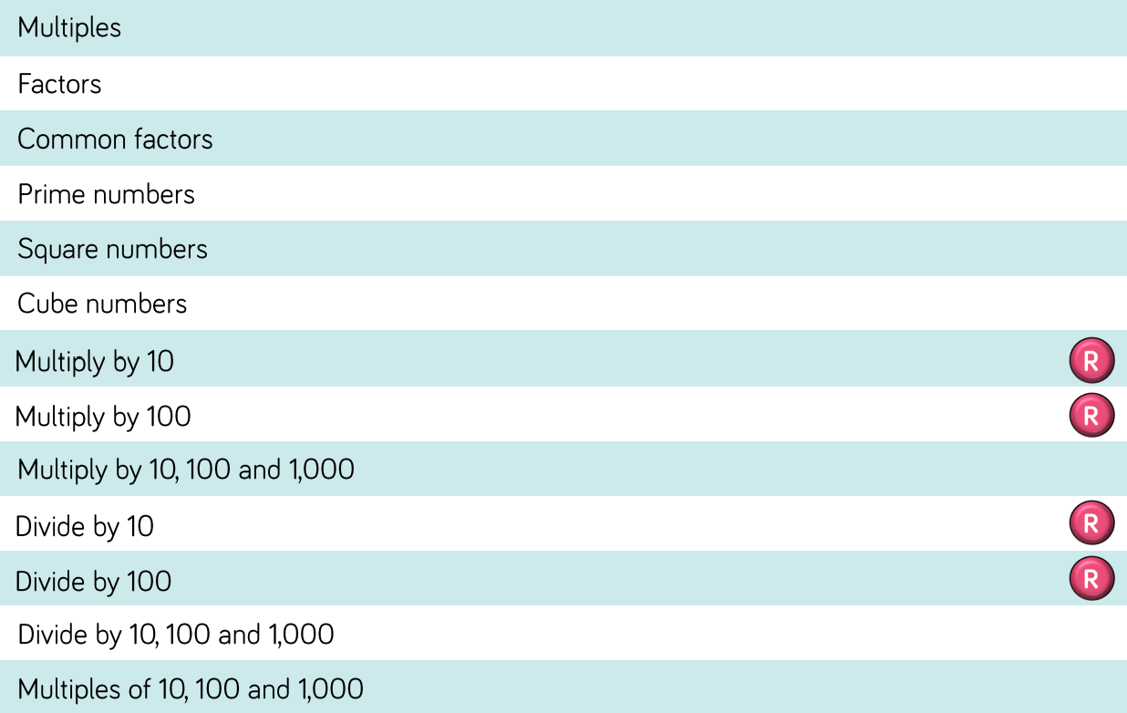
Year 5

Slide 7
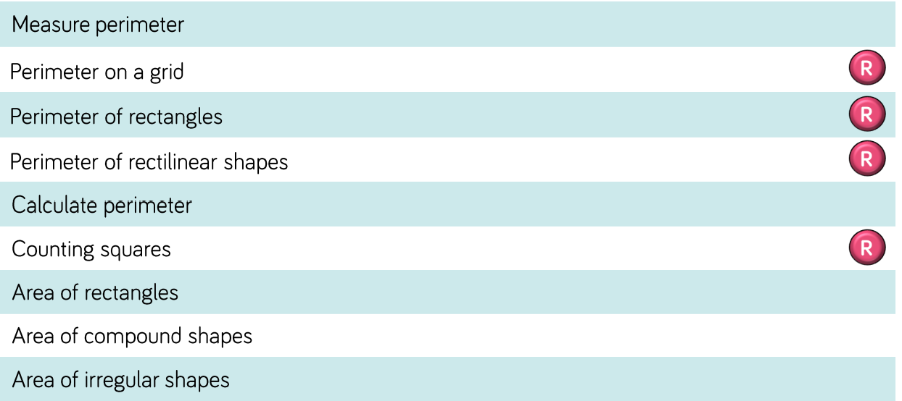
Year 5

