Slide 1
Year 5 Spring Scheme of Learning

Slide 2
Year 5

Slide 3
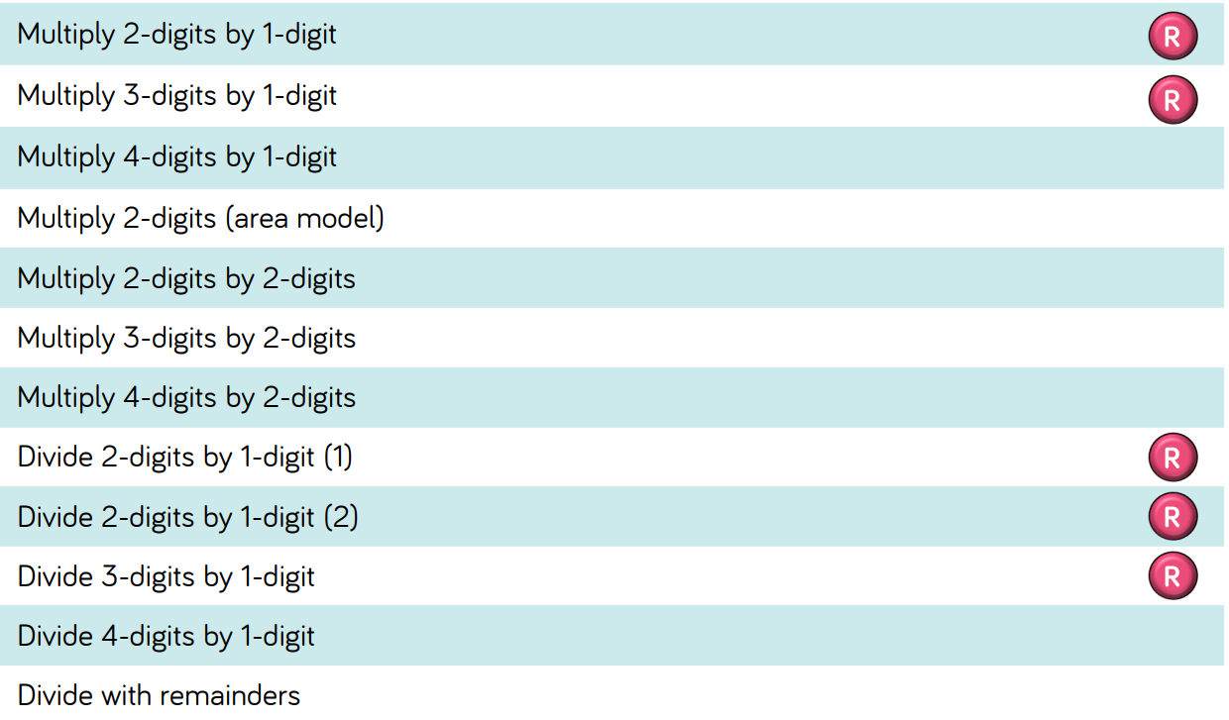
Year 5

Slide 4
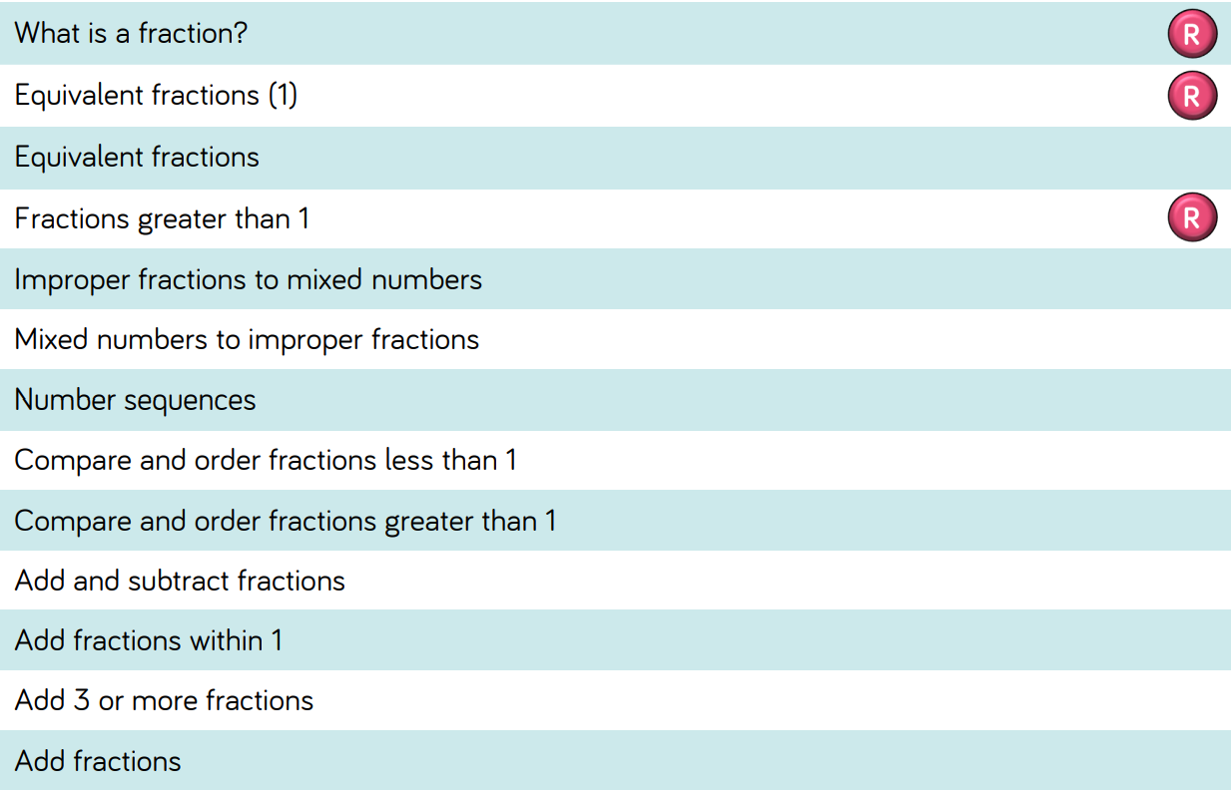
Year 5

Slide 5
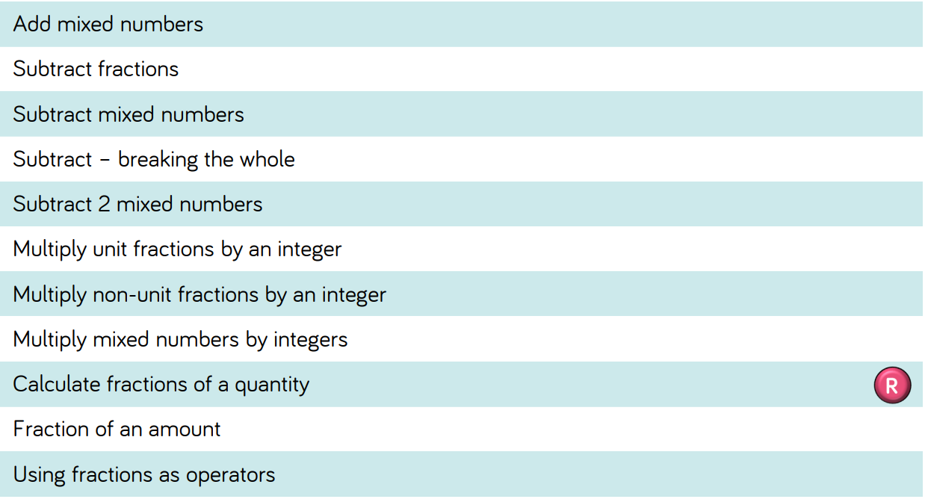
Year 5

Slide 6
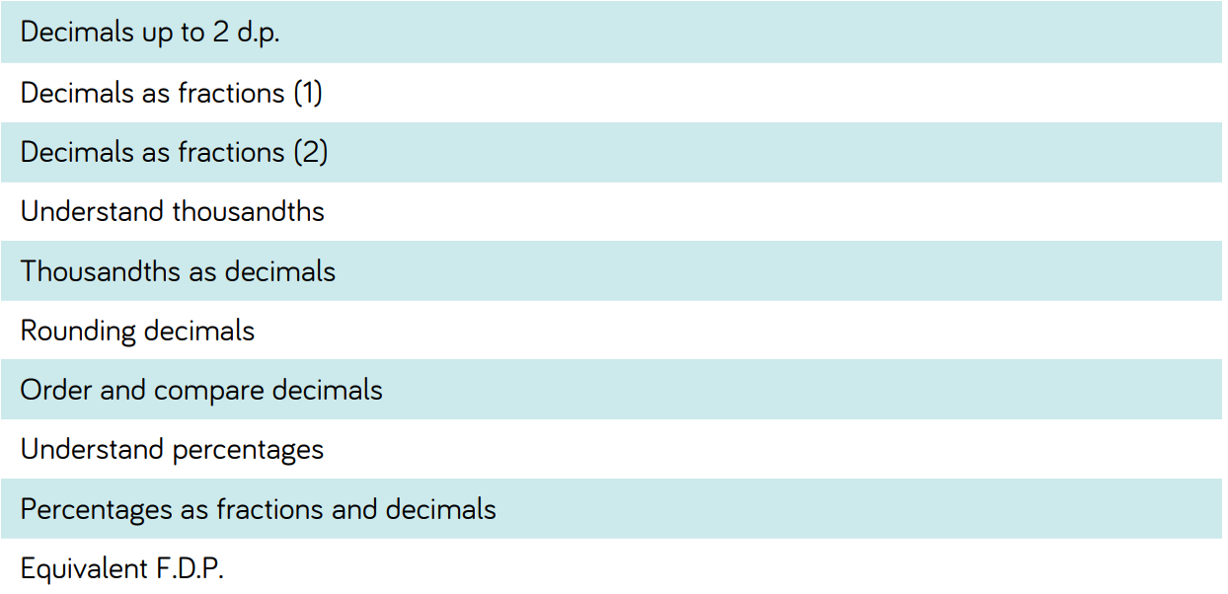
Year 5

