Slide 1
Year 6 Autumn Scheme of Learning

Slide 2
Year 6

Slide 3
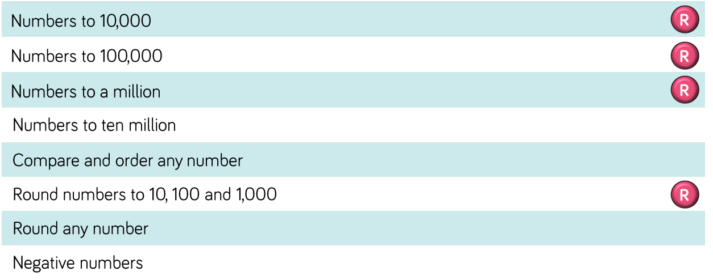
Year 6

Slide 4
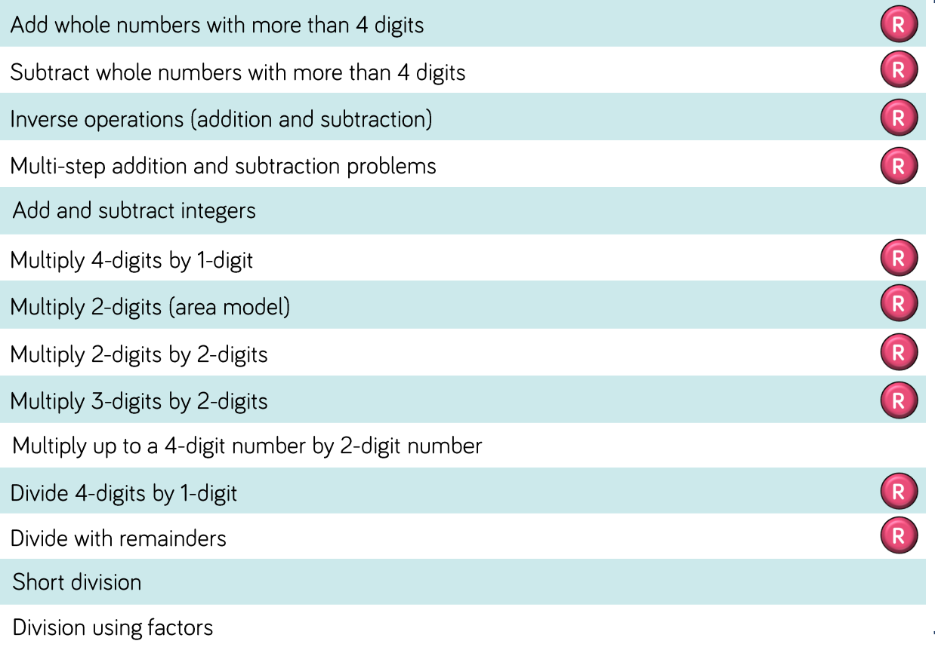
Year 6

Slide 5
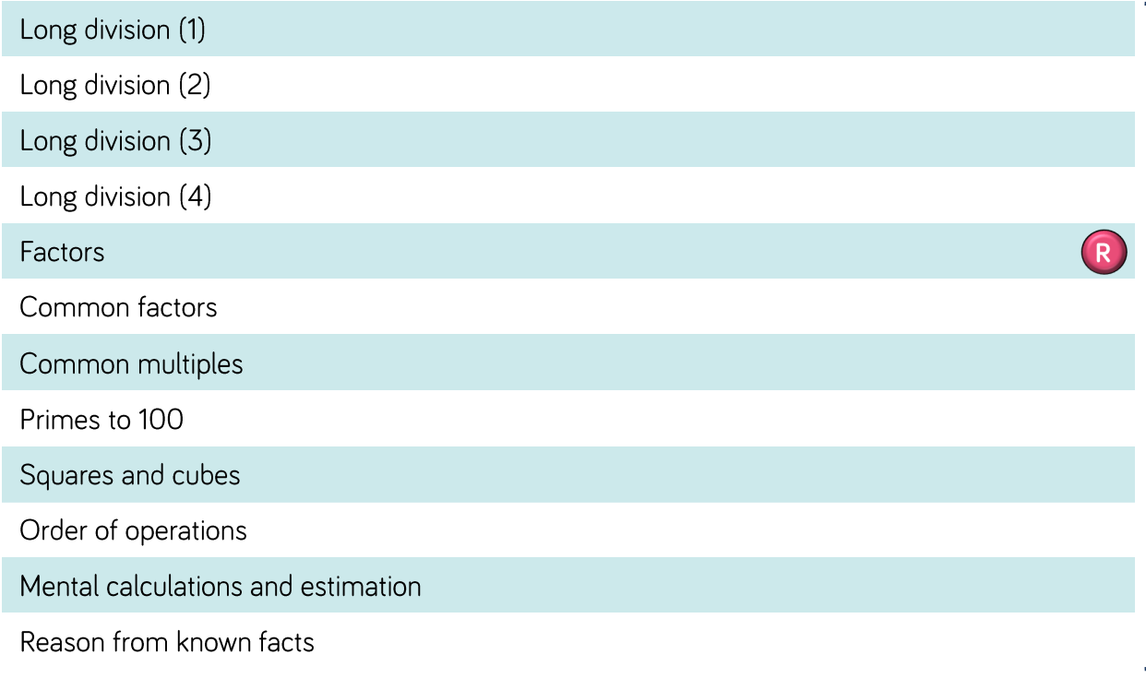
Year 6

Slide 6
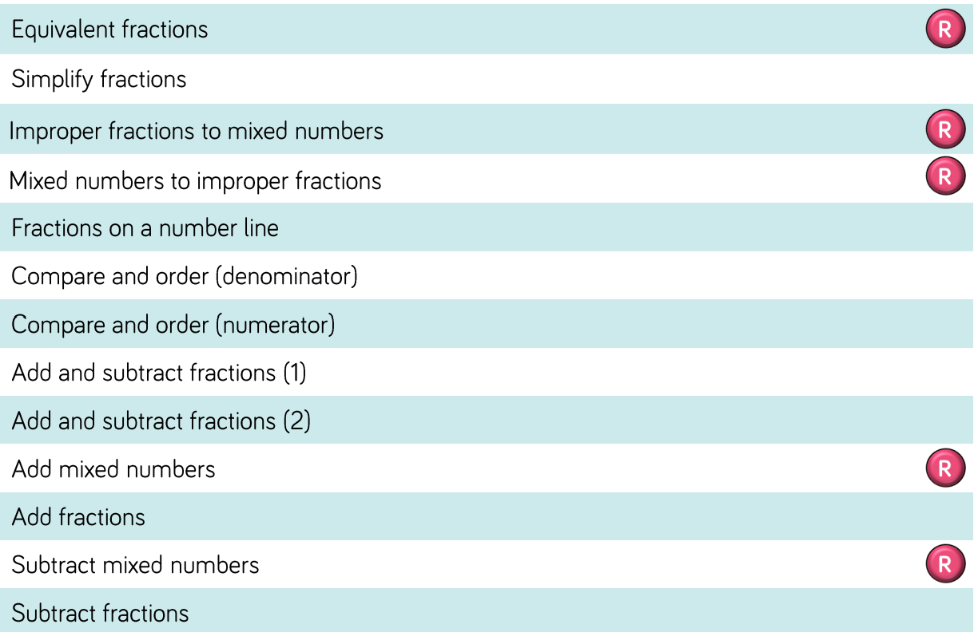
Year 6

Slide 7
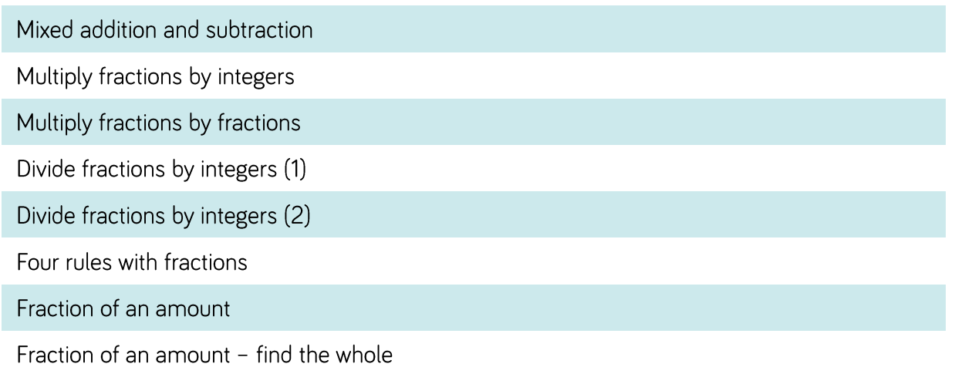
Year 6

Slide 8
Year 6

