Slide 1
Year 4 Summer Scheme of Learning

Slide 2
Year 4

Slide 3
Year 4

Slide 4
Year 4

Slide 5
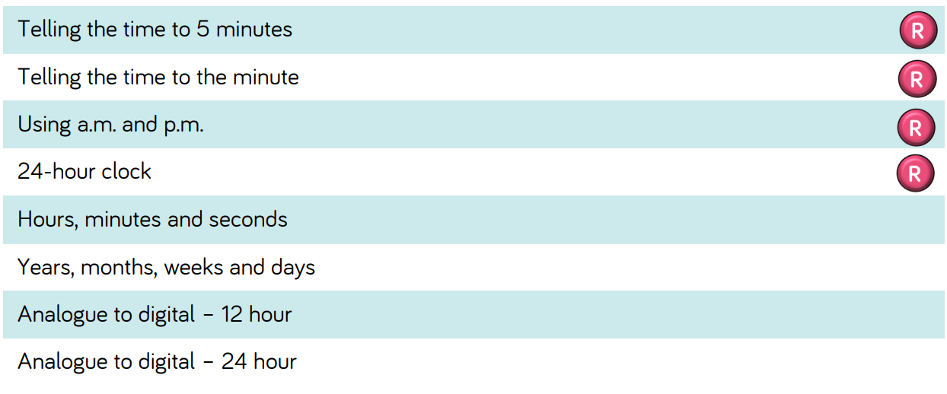
Year 4

Slide 6
Year 4

Slide 7
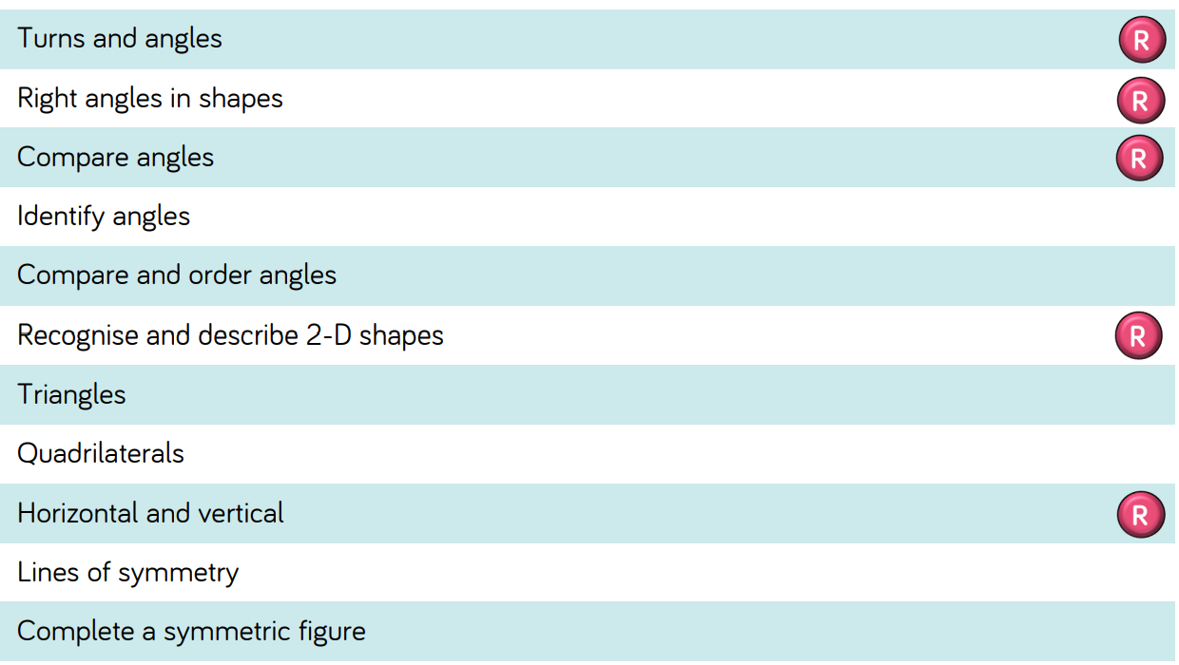
Year 4

Slide 8
Year 4

